Slide 1


KASUKABE DEFENCE FORCE
YOGA DELIGHT
HEALTHCARE20 | SUSTAINIBILITY20

Slide 2



Problem Statement
Problem 1
Obesity and lack of exercise in daily routine is one of the major reasons for all the health issues among youngsters nowadays.
Problem 2
Yoga is one of the popular option to fill this void. However, availability of an instructor is a cumbersome task. Individuals find it difficult to manage it along with their busy schedules.
Problem 3
Cost of enrolling in such a yoga course could be expensive and not pocket-friendly for many. This leads a person to neglect their health.

Slide 3

Project Idea/ Objectives
A yoga application which detects posture using artificial intelligence. The virtual AI yoga trainer uses pose recognition tool for the application. With real-time data captured from camera, a person can get feedback in the application on the accuracy of their pose and keep track of their fitness goal. This application can be put to use where a Yoga/fitness enthusiast can practice Yoga without the need of an instructor. The user can practice Yoga efficiently at his/her own pace with any number of attempts. The principle reason of the project is to have a user practice Yoga poses accurately and be able to keep a track of daily Yoga routine. It can provide real-time feedback on the person's form and technique, ensuring that they are performing the poses correctly and minimizing the risk of injury. With a yoga AI model website, users can choose the length and intensity of their yoga sessions, allowing them to fit their practice into their busy schedules. It can provide users with access to a wealth of information about yoga, including pose tutorials, instructional videos, and articles on yoga philosophy and history. This can enhance users' learning and deepen their understanding of the practice.

Slide 4



Key Features
AVAILABILITY
AFFORDABILITY
DATA-DRIVEN PROGRESS TRACKING
An AI Yoga Trainer can be available 24/7, unlike a human yoga instructor who may have limited availability. This means that people can practice yoga at their convenience.
Hiring a personal yoga instructor can be expensive, but an AI Yoga trainer can be more affordable and accessible to more people.
An AI yoga trainer website can use data to track users' progress over time, providing them with insights into their fitness levels, flexibility, and overall wellness. This feature can motivate users to continue their practice and achieve their fitness goals.

Slide 5


SUSTAINIBILITY DEVELOPMENT
GOALS

Slide 6
TechStack Used
Project Details
The software components used in a yoga pose classifier include programming languages such as Python, machine learning libraries such as TensorFlow and computer vision libraries such as OpenCV.
The hardware components may include a camera or a video capture device, a CPU or GPU for processing the input data, and a display device for showing the recognized yoga pose.

Slide 7
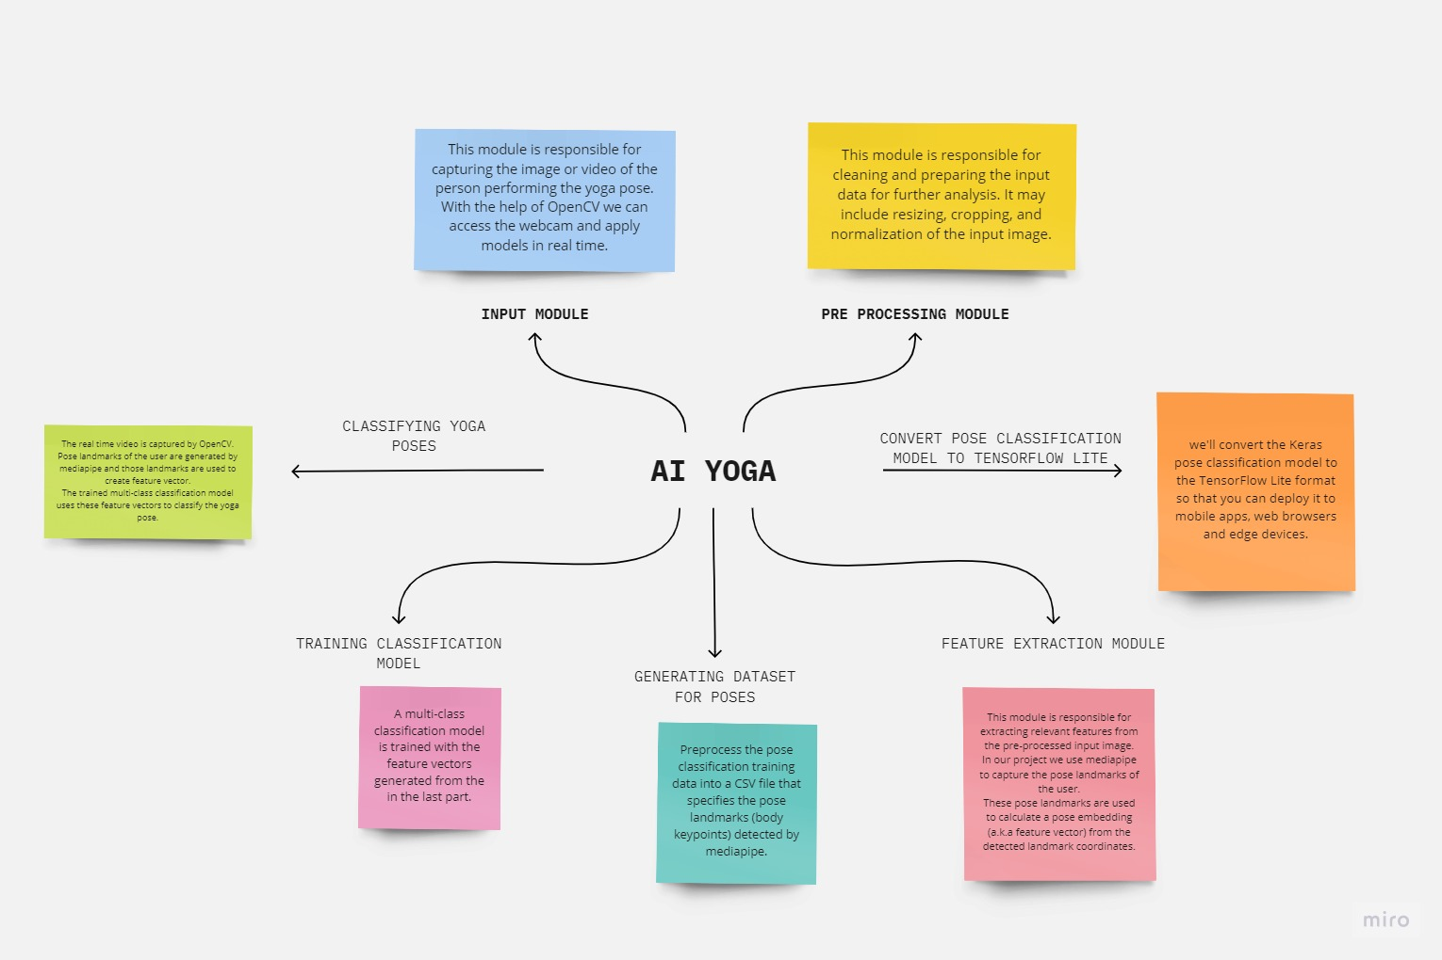
Flowchart
Project Details

Slide 8

Describe your use case
Describe your showstopper
Login and Signup will be provided for different accounts.
Posture detection feature will check the correctness of your posture along with recognising it. It will guide the user about the correct position of the joints.
A tracker will keep record of all your progress.
Report analyser will provide you with the feedback till date .
A blog page will be provided where users can share their experiences.
Personalization: AI Yoga trainer can provide personalized recommendations based on an individual's fitness level, health conditions, and goals.
Flexibility: Users can choose the length and intensity of their yoga sessions, allowing them to fit their practice into their busy schedules.
Continuous improvement: This website can continually analyze user data and feedback to improve the AI model's performance and accuracy Interactive
Experience: It can provide an interactive experience that simulates the feel of a physical yoga class.
On-demand Content: It can offer on-demand content that users can access anytime they want.

Slide 9
TEAM LEADER:
JATIN SINGH SAGOI
Team Member
Details
DR AKHILESH DAS INSTITUTE OF TECHNOLOGY AND MANAGEMENT
2ND YEAR
sagoisinghjatin9951@gmail.com
TEAM MEMBER 1:
SANYA TIWARI
DR AKHILESH DAS INSTITUTE OF TECHNOLOGY AND MANAGEMENT
2ND YEAR
sanyatiwari4@gmail.com
TEAM MEMBER 2:
TISHA SINGHAL
DR AKHILESH DAS INSTITUTE OF TECHNOLOGY AND MANAGEMENT
2ND YEAR
tishasinghal8@gmail.com
TEAM MEMBER 3:
DEVESH SHARMA
DR AKHILESH DAS INSTITUTE OF TECHNOLOGY AND MANAGEMENT
2ND YEAR
devesh1002@gmail.com

